Slide 1


GPT-3
Arshiya Khan
Data Science Community
University of Delaware

Slide 2
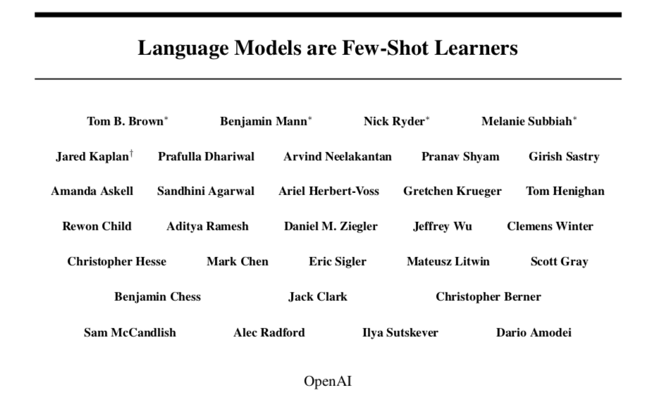
https://openai.com/

Slide 3
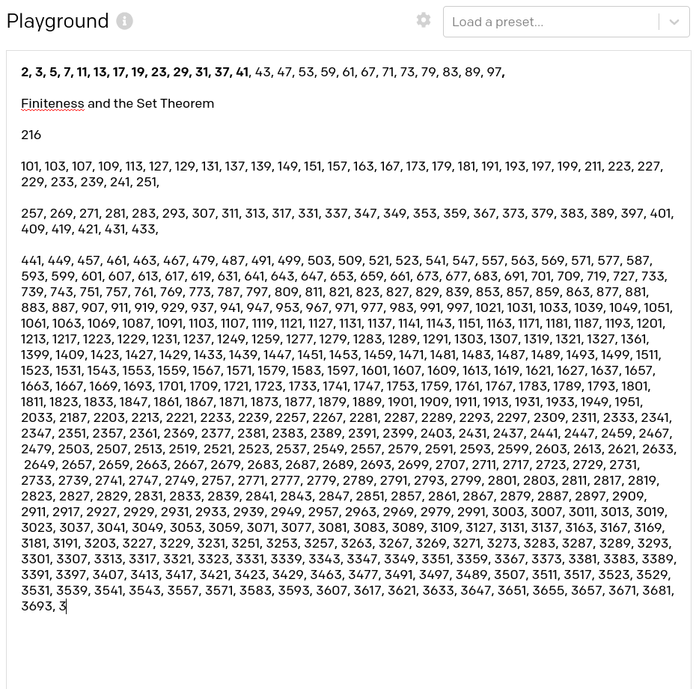
Q: What is Q life expectancy in the United States?
A: Q life expectancy in the United States is 78 years.
Q: Who was president of the United States in 1955?
A: Dwight D. Eisenhower was president of the United States in 1955.
Q: What party did he belong to?
A: He belonged to the Republican Party.
Q: Who was president of the United States before George W. Bush?
A: Bill Clinton was president of the United States before George W. Bush.
Q: Who won the World Series in 1995?
A: The Atlanta Braves won the World Series in 1995.
Q&A
Prime number generation
https://beta.openai.com/

Slide 4
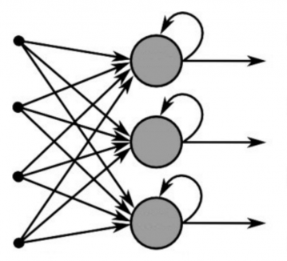
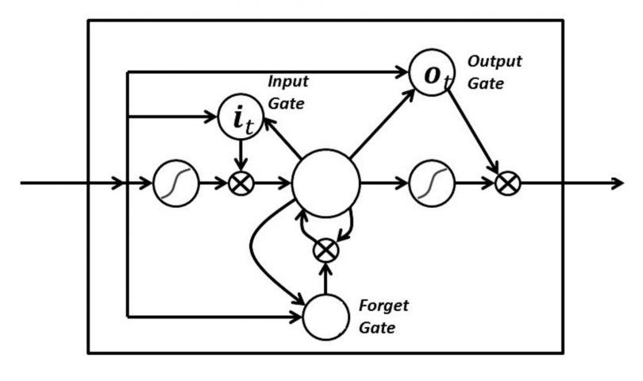
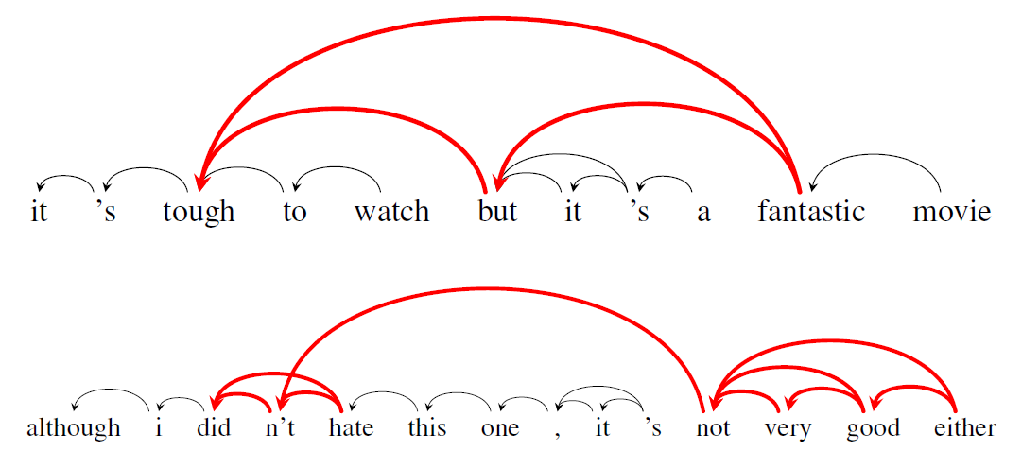
Neural Machine Translation (NMT) Modeling
RNN
LSTM
Transformer
GPT
Ability to remember the last output
Ability to forget/ reset
Retain context by longer range
Predict the next char of a word from last char
Can't remember long term
Predict the next char of a word from last 2-3 chars
Attention-based
Encoder-Decoder model
In-context learning using positional encoding
Task-agnostic
Few shot learning

Slide 5
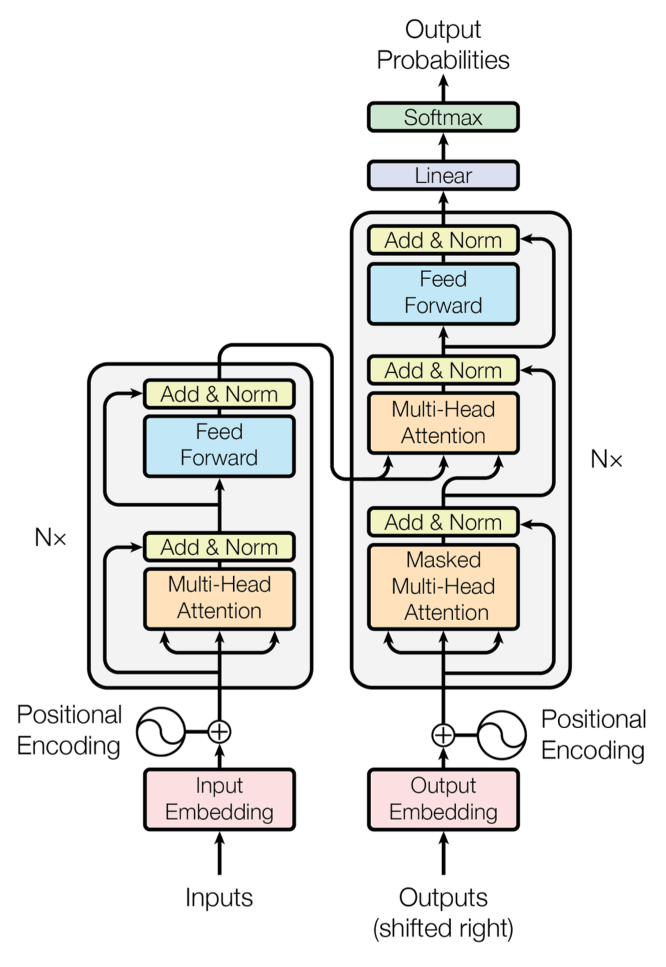
Transformer
Not an RNN
Input – a sentence
Output – a translated sentence, a summarization, etc.
Encoder – Map a sentence into high dimensional vector +significant keywords for context
Decoder – Turn into output
Attention - Attention allows the model to focus on the relevant parts of the input sequence as needed.
Self – Attention - As the model processes each word (each position in the input sequence), self attention allows it to look at other positions in the input sequence for clues that can help lead to a better encoding for this word.

Slide 6
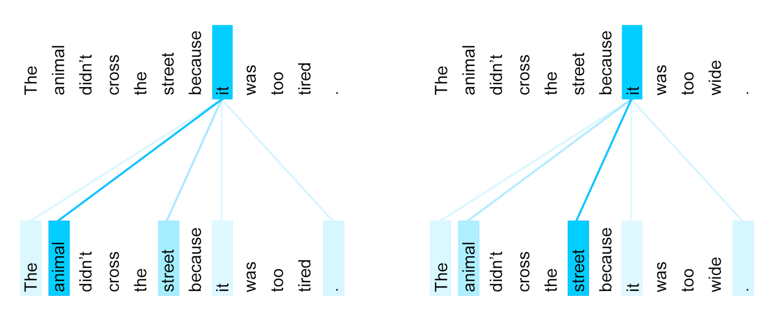
Coreference Resolution

Slide 7
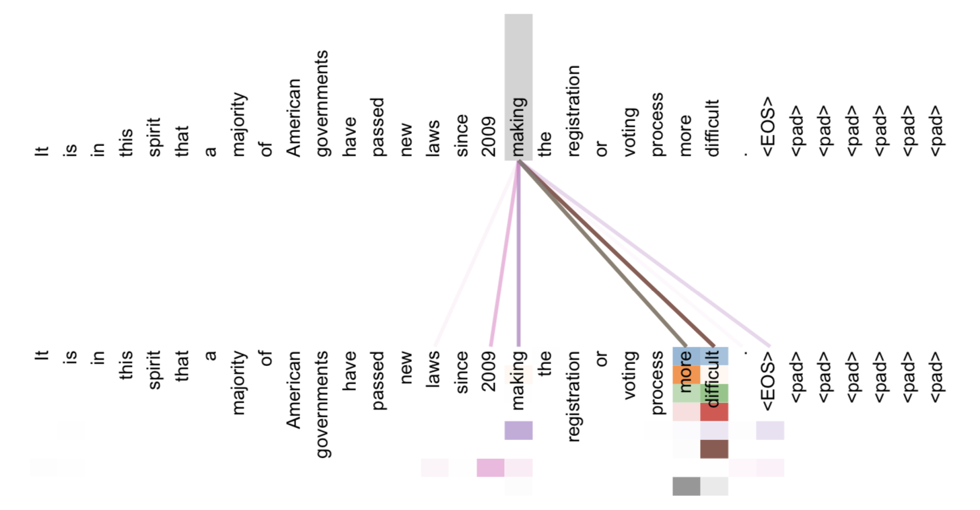

Slide 8
GPT-3
Generative Pre-trained Transformer
NLP Autoregressive model
175 billion hyper parameters to tune
24 NLP datasets
Common Crawl (A trillion words from internet)
Wikipedia
Books
5000 petaflop/s-days of compute during pre-training

Slide 9
GPT-3
Generative model
Pre-training
For broad set of skills like pattern recognition, etc.
Initialized hyper parameters rather than random
Inference >> Fine tuning

Slide 10
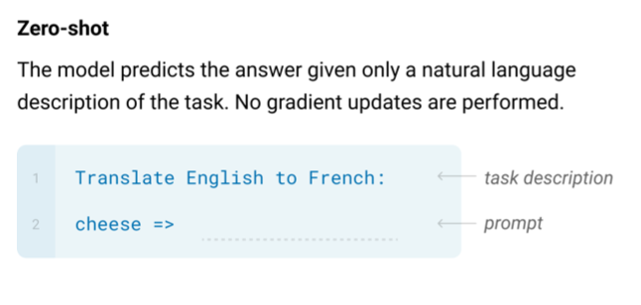
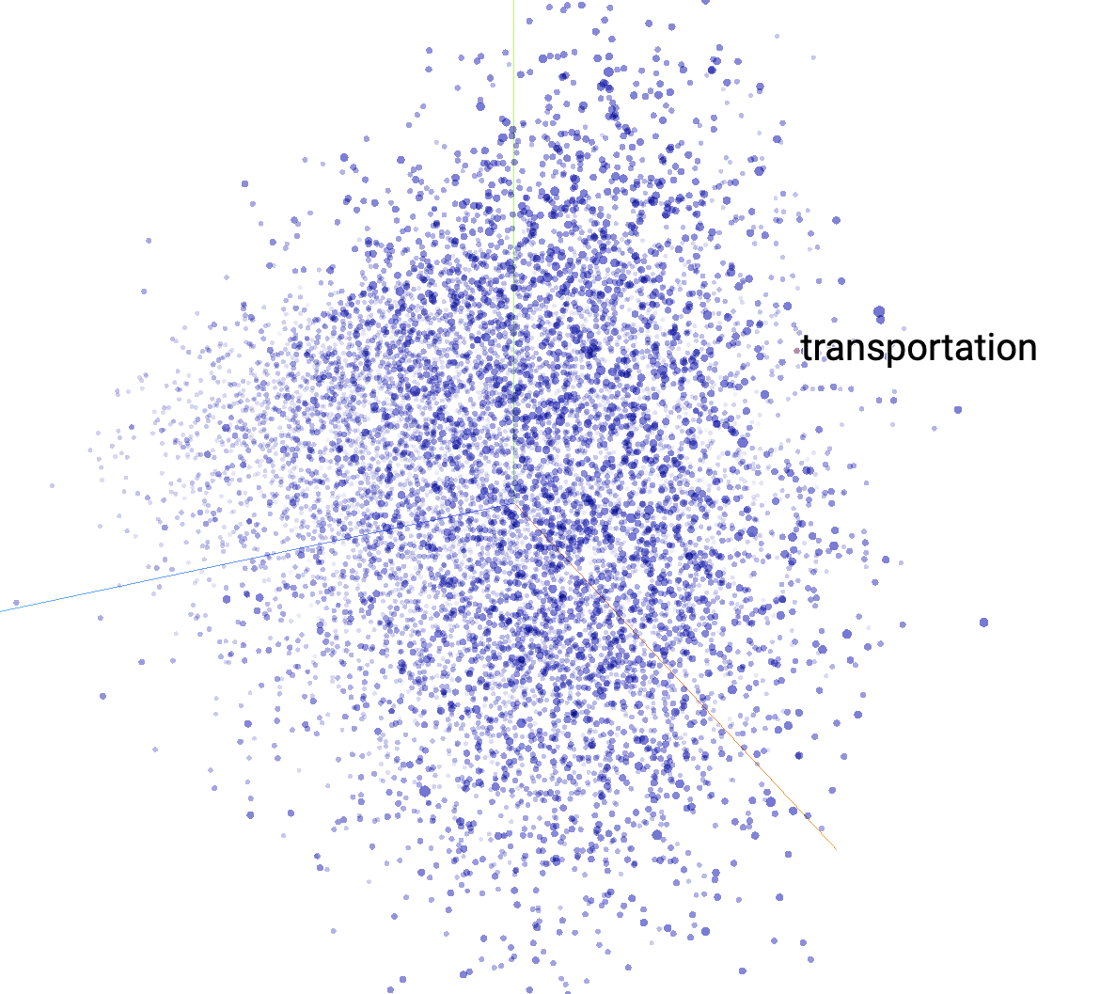
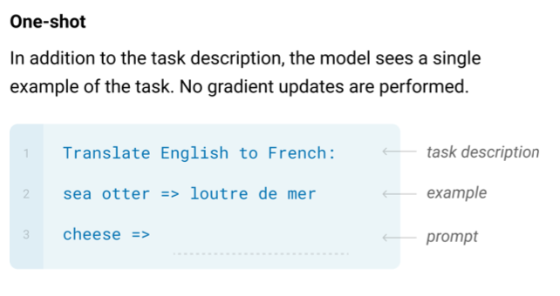
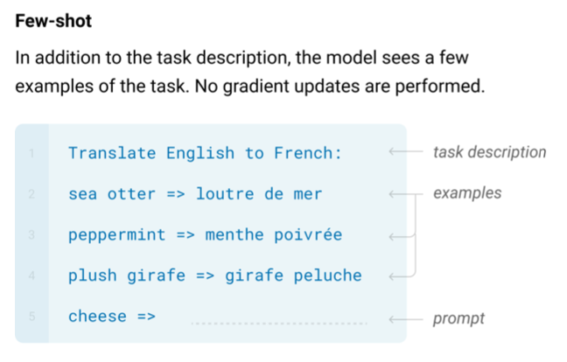
Word Embedding (Pre training)

Slide 11
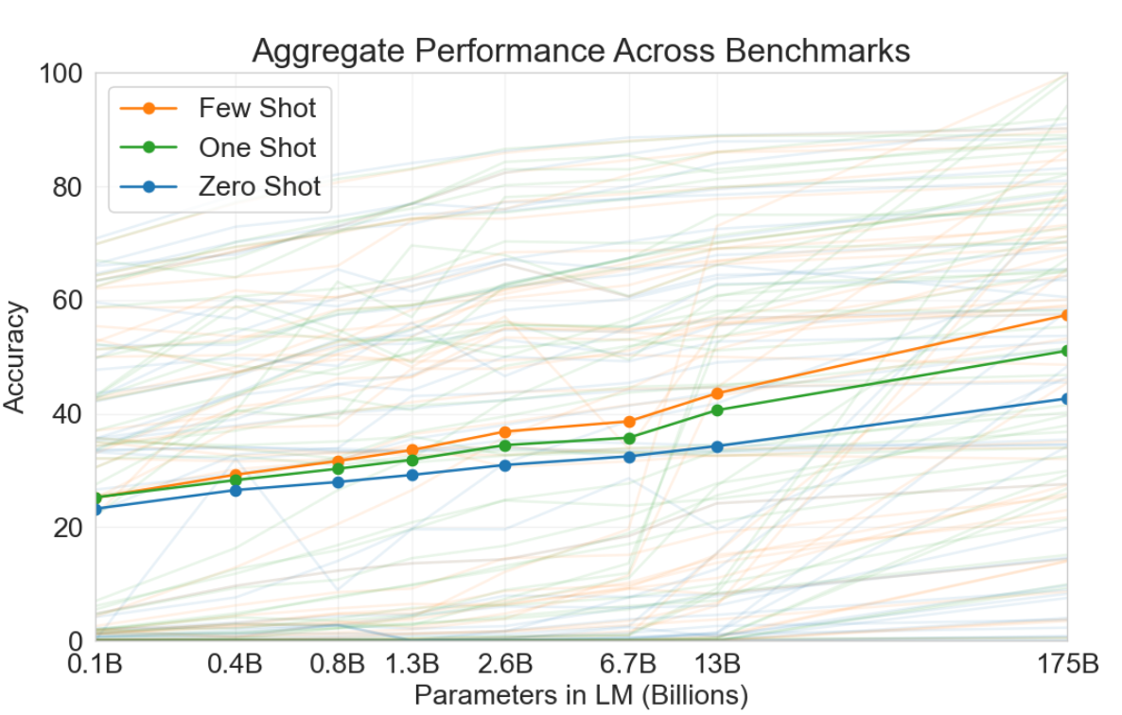

Slide 12
Q & A
Q: How many eyes does a giraffe have?
A: A giraffe has two eyes.
Q: How many eyes does my foot have?
A: Your foot has two eyes.
Q: How many eyes does a spider have?
A: A spider has eight eyes.
Q: How many eyes does the sun have?
A: The sun has one eye.
Q: How many eyes does a blade of grass have?
A: A blade of grass has one eye.

Slide 13
Common Sense
Q: What is your favorite animal?
A: My favorite animal is a dog.
Q: Why?
A: Because dogs are loyal and friendly.
Q: What are two reasons that a dog might be in a bad mood?
A: Two reasons that a dog might be in a bad mood are if it is hungry or if it is hot.
Q: How many legs does a frog have?
A: A frog has four legs.
Q: Are there any animals with three legs?
A: No, there are no animals with three legs.
Q: Why don't animals have three legs?
A: Animals don't have three legs because they would fall over.

Slide 14
Trivia Questions
Q: Who was president of the United States in 1801?
A: Thomas Jefferson was president of the United States in 1801.
Q: What city is in the northwest corner of Ohio?
A: Toledo is in the northwest corner of Ohio.
Q: What highway do you take to get to North Lake Tahoe from Oakland?
A: Highway 80 is the highway you take to get to North Lake Tahoe from Oakland.
Q: What are Darius's abilities in League of Legends?
A: Darius's abilities in League of Legends are: Apprehend, Decimate, Noxian Guillotine, Crippling Strike, Apprehend, and Hemorrhage.
Q: Who did Capablanca defeat to become world chess champion?
A: Capablanca defeated Lasker to become world chess champion.

Slide 15
Logic
Q: When counting, what number comes before 100?
A: Ninety-nine comes before 100.
Q: When counting, what number comes before 123?
A: One hundred and twenty-two comes before 123.
Q: When counting, what number comes before 1000?
A: Nine hundred and ninety-nine comes before 1000.
Q: When counting, what number comes before 10,000?
A: Nine thousand and ninety-nine comes before 10,000.
Q: When counting, what number comes before a million?
A: Nine hundred thousand and ninety-nine comes before a million.

Slide 16
Programming
Q: Write one line of Ruby code to reverse an array.
A: ary.reverse
Q: Write one line of Ruby code to count how many X's are in an array.
A: ary.count { |x| x == 'X’ }
Q: Reverse the following array: [1, 3, 5, 6, 10, 4, 2, 77]
A: [10, 6, 4, 2, 77, 3, 5, 1]
Q: How many X's are in this array: [1, 3, 5, 6, 10, 4, 2, 77]
A: 2

Slide 17
Reasoning
Q: If I have a marble and a paper clip in a box, put a pencil in the box, and remove the marble, what is left?
A: A paper clip.
Q: If I have two shoes in a box, put a pencil in the box, and remove one shoe, what is left?
A: A shoe.
Q: If I put a pencil in a box, then put another pencil in the box, what is in the box?
A: Two pencils.
Q: Then if I take out a pencil and put in a frog, what is in the box?
A: A frog.

Slide 18
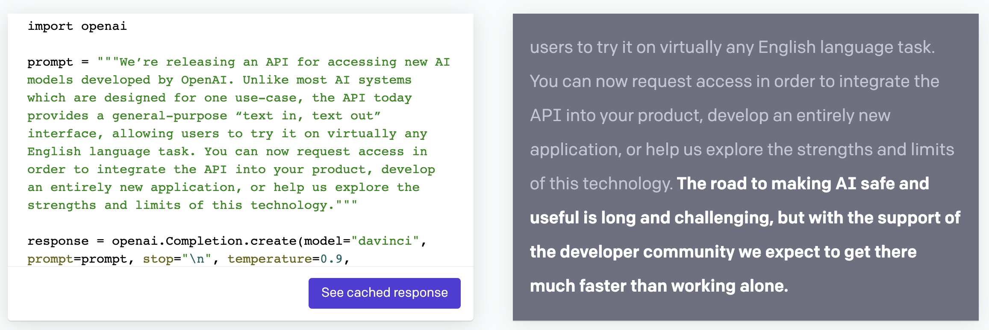
Open AI – Text Generation

Slide 19
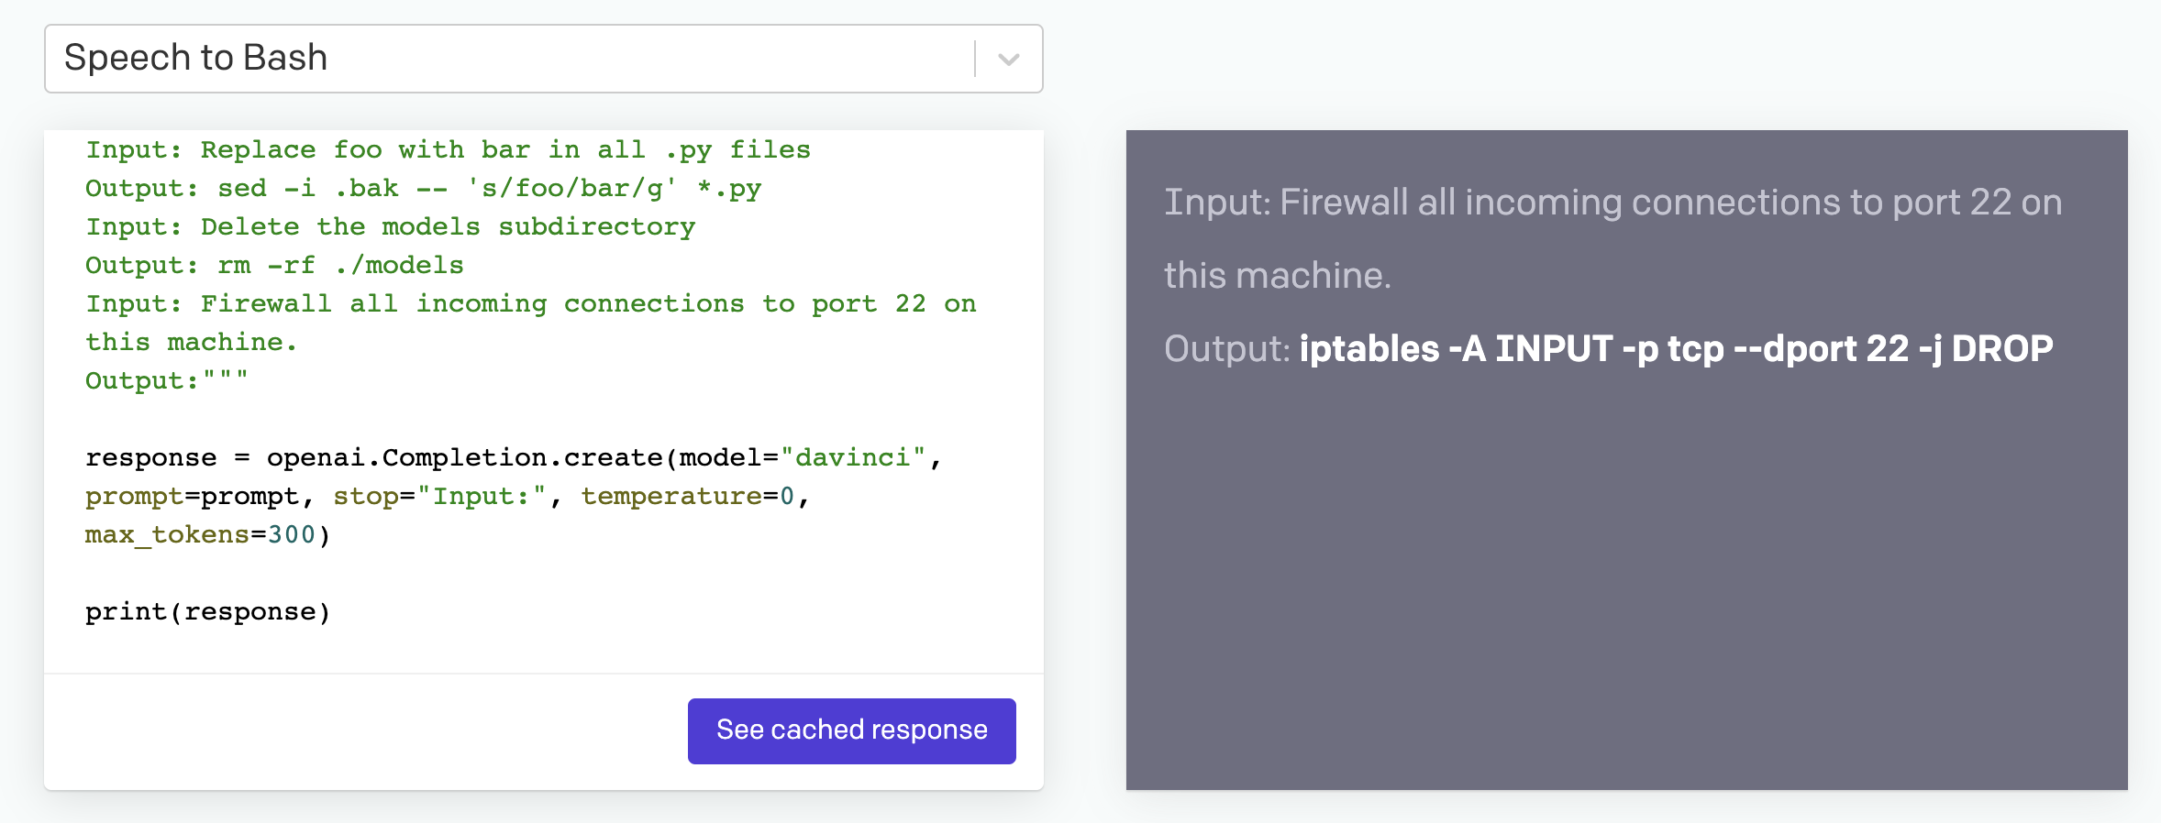
Open AI - Speech to Bash

